Slide 1
Effect of US Macro -Economic Factor on Indian Stock Market

Slide 2
WHAT IS US MACRO-ECONOMIC FACTORS?
A macroeconomic factor is an influential fiscal, natural, or geopolitical event that broadly affects a regional or national economy.
Macroeconomic factors tend to impact wide swaths of populations, rather than just a few select individuals.
Examples of macroeconomic factors include economic outputs, unemployment rates, and inflation.
These indicators of economic performance are closely monitored by governments, businesses, and consumers alike.
KEY TAKEAWAYS:
A macroeconomic factor is an influential fiscal, natural, or geopolitical event that broadly affects a regional or national economy.
The relationships between various macroeconomic factors are extensively studied in the field of macroeconomics.
Examples of macroeconomic factors include economic outputs, unemployment rates, and inflation.

Slide 3
MACRONOMICS FACTOR:
GDP OR GROSS-DOMESTIC PRODUCT:
Gross domestic product (GDP) is the total monetary or market value of all the finished goods and services produced within a country’s borders in a specific time period. As a broad measure of overall domestic production, it functions as a comprehensive scorecard of a given country’s economic health.
CRUDE OIL :
The result of variance decomposition indicates that each country in the region reacts differently to crude oil price volatility which reflects their macroeconomics fundamentals, independent policy, sector structure, and country differences. The findings support change in public policies in a way to reduce their dependency on oil energy and encourage them toward renewal and green energy sources for better environmental results and sustainable development.
DOLLAR INDEX:
Whenever there is any negative news in the US markets, it largely affects the global markets, especially Indian Stock Markets.
As we are connected with the whole world through various businesses, every company is connected directly or indirectly to another for fulfilling their business purpose.
10-year yield:
The US bond yields are very influential globally as they attract funds from investors all across the world.
When the yields increase then it also indicates that the Fed might raise interest rates for controlling inflation.

Slide 4
PROJECT INSIGHTS

Slide 5
SOME KEYPOINTS :
As of May 8th, 2020, in India, 56,342 positive cases have been reported. India, with a population of more than 1.34 billion—the second largest population in the world—will have difficulty in controlling the transmission of severe acute respiratory syndrome coronavirus 2 among its population.
The Indian government implemented a 55-days lockdown throughout the country that started on March 25th, 2020, to reduce the transmission of the virus.
This outbreak is inextricably linked to the economy of the nation, as it has dramatically impeded industrial sectors because people worldwide are currently cautious about engaging in business in the affected regions.
The first wave of the COVID-19 pandemic commenced with increased detection of cases in January-March 2020, and after the September 2020 peak, cases declined by the end of October 2020.
Subsequently, a low COVID-19 incidence period occurred between November and mid-February.
However, the recent second wave in India in April-May 2021 placed an unprecedented burden on the Indian health systems, which contributed almost 47% of single-day incident cases in the world during its peak.

Slide 6
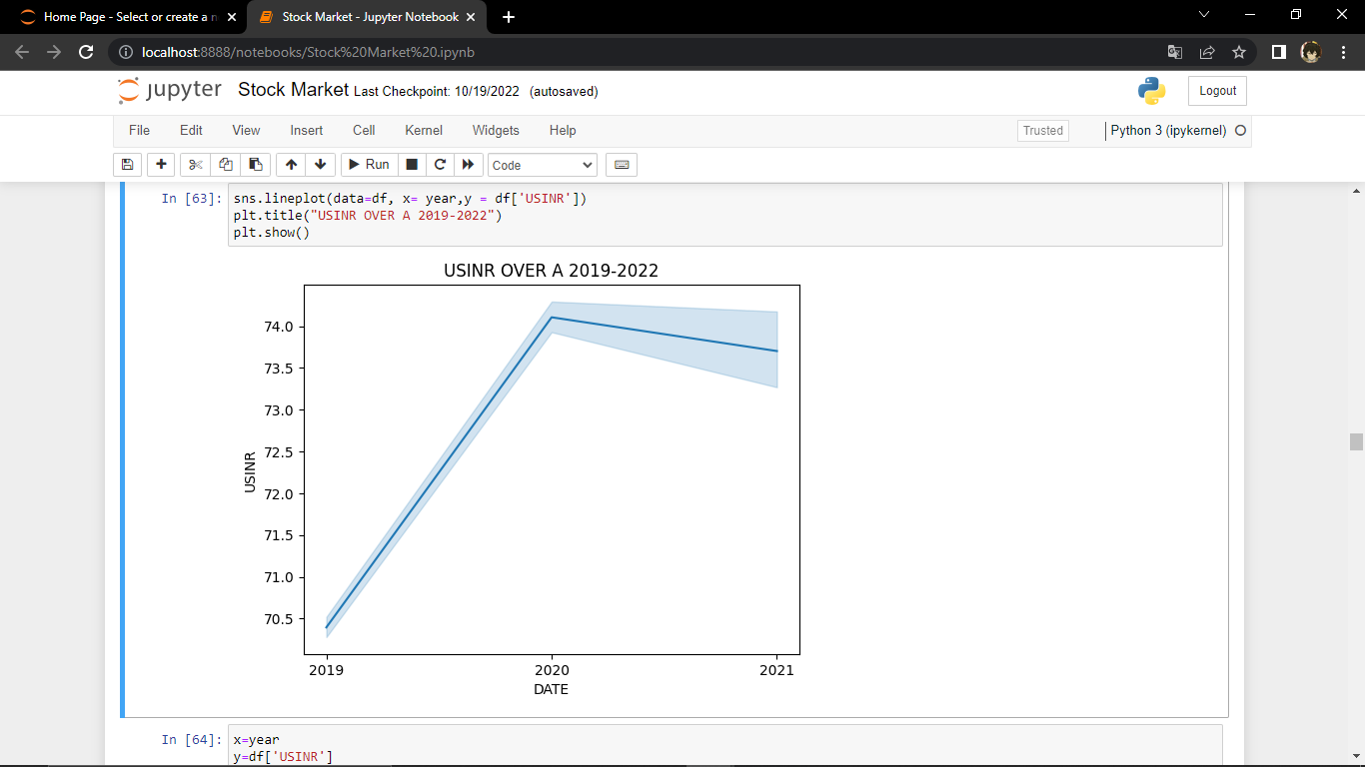
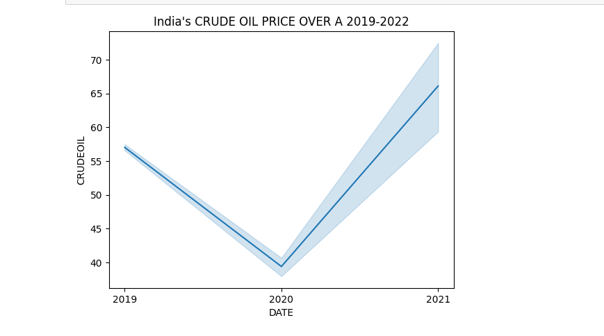
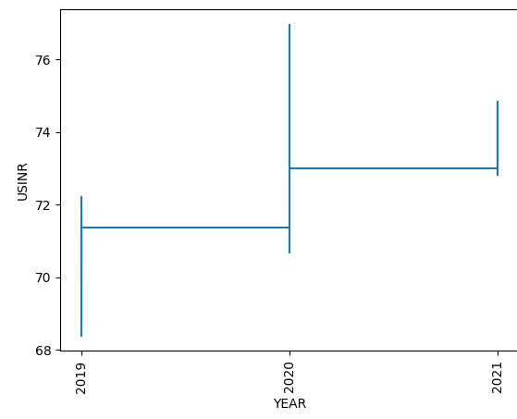
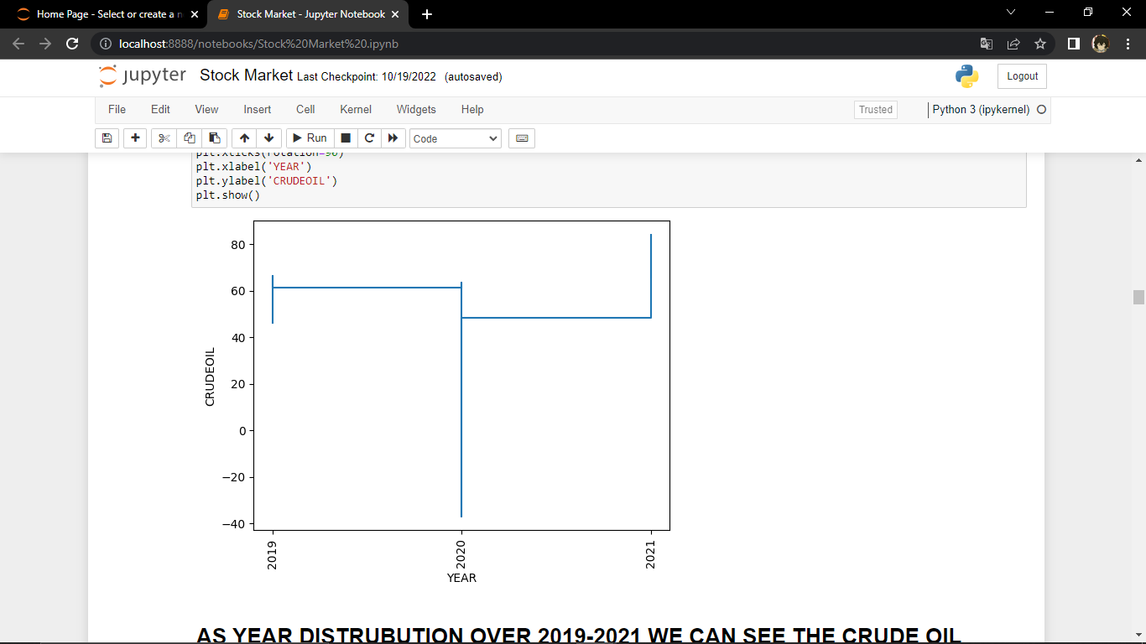
CRUDE OIL AFFECT ON INDIA ECONOMY:
AS YEAR DISTRUBUTION OVER 2019-2021 WE CAN SEE THE CRDE OIL PRICE WAS DECREASED....AROUND 2020 IT WAS COVID MAJOR INCREASED OF COVID.
AS YOU CAN SEE THE AS CRUDE OIL PRICE DECREASED OVER 2019-2021 . THE INDIA ECONOMY DECREASED OVER THE PERIOD WHEN THE COVID WAS ACTIVE AND BECOME STABLE OVER 2021

Slide 7
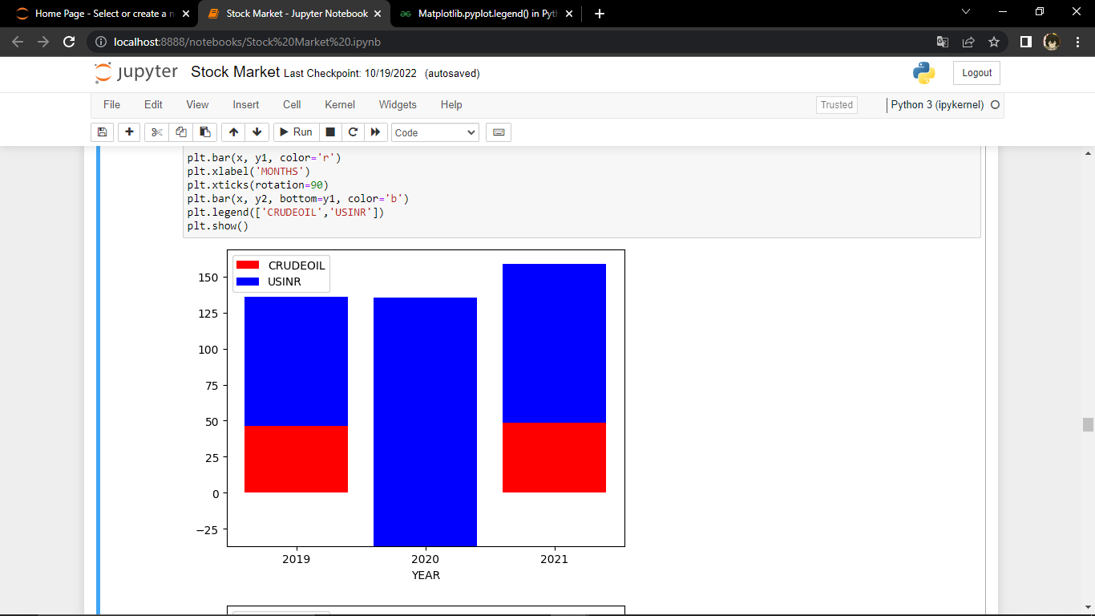
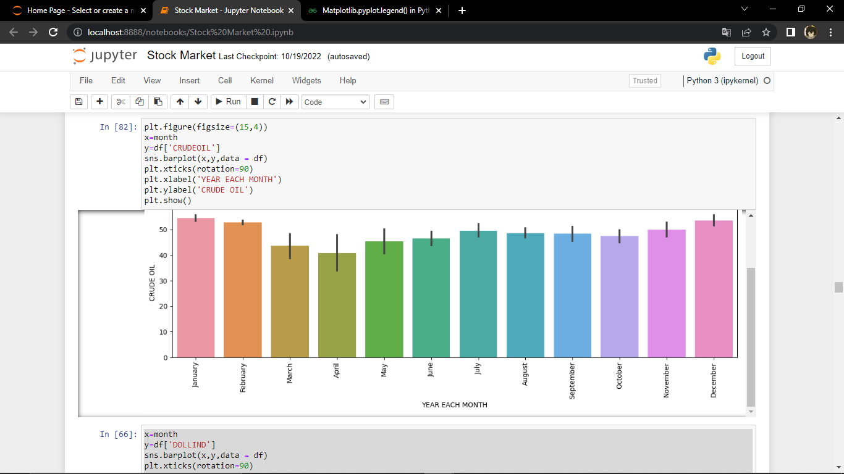
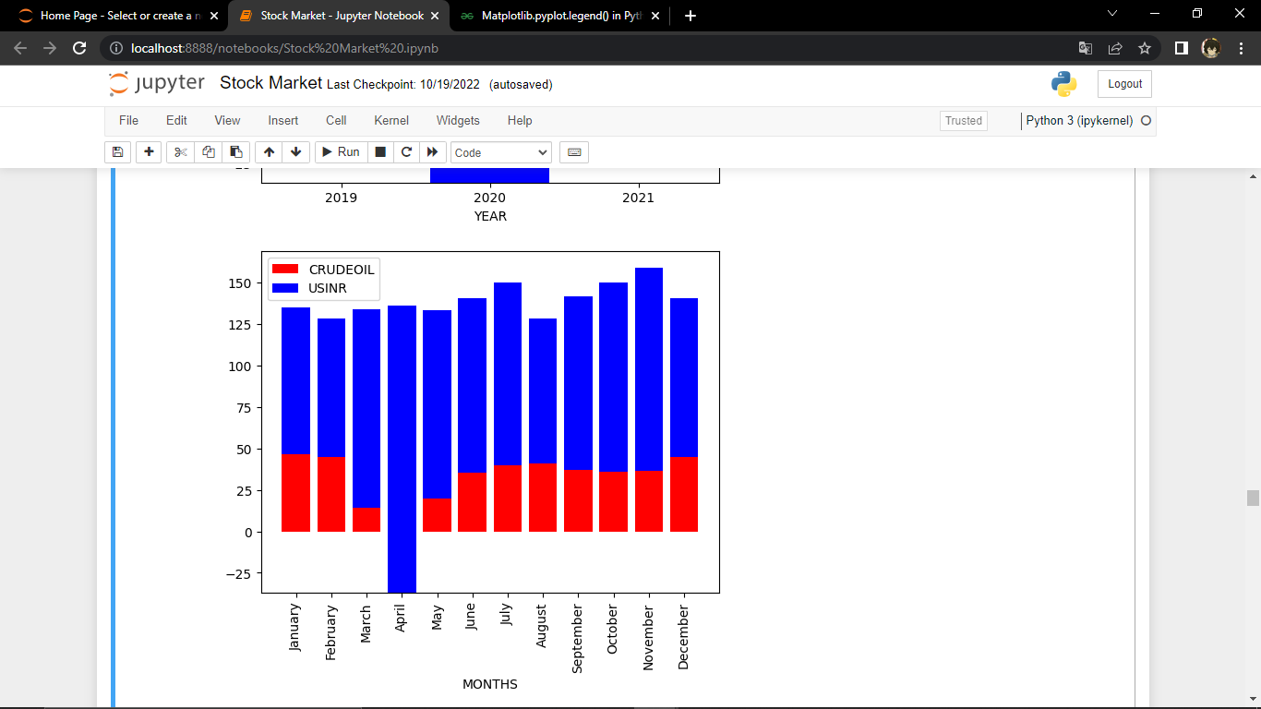
CRUDE OIL EFFECTS OVER MONTH VS USINR
IN THIS YOU CAN SEE THE CRUDE OIL PRICE GOT A HIT IN THE ACTIVE PERIOD OF COVID WHICH January-March 2020 & April-May 2021 . ALSO YOU CAN SEE THE THE THERE MAJOR RISE IN 2020 BECAUSE IT WAS MAJOR ACTIVE ZONE ALSO THE USINR DOES NOT HAVE ANY SIGHTS WE CAN SEE THE USINR INCREASED SO MUCH AND ALSO YOU CAN SEE THE CRUDE OIL IS SO MUCH LOW ITS BEEN VERY LOW WHCH RESULTS TO INCRESE THE INDIA ECONOMY TO VERY HIGH .

Slide 8
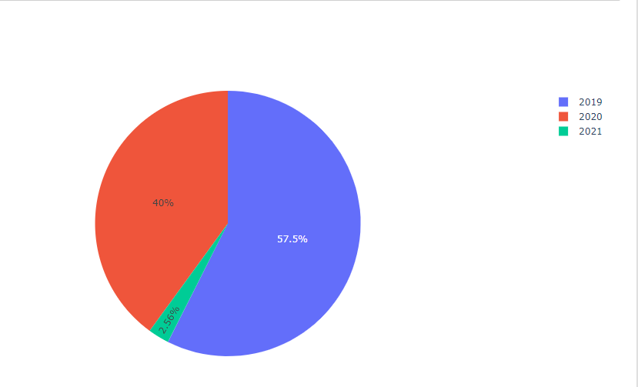
Crude oil over 2019-2021 (PIE CHART):
AS YOU CAN SEE THE CRUDE OIL DECREASED BY 17.5% APPROX. 20% DECREASED IN CRUDE OIL PRICE ,WHICH AGAIN SHOWS THE INCREASE OF USINR WHICH WAS INCREASE BECAUSE OF THE DECREASED OF CRUDE OIL PRICES.

Slide 9
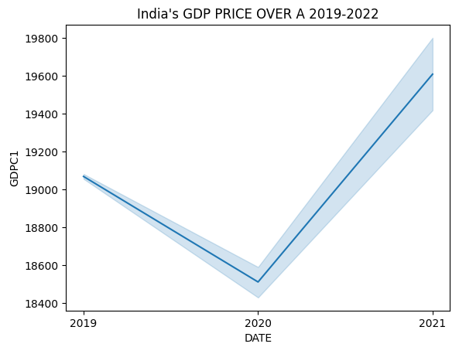
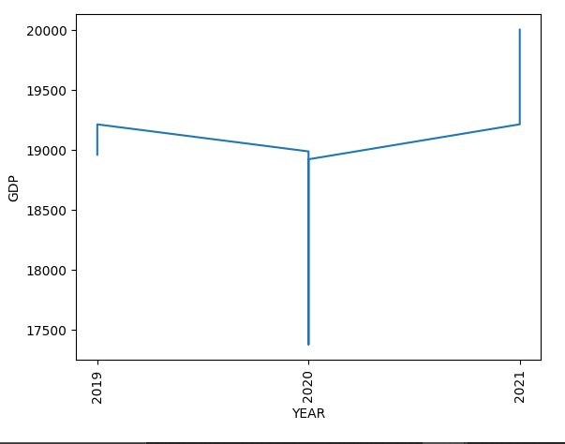
GDP AFFECT ON INDIA ECONOMY:
AGAIN AS YOU SEE THE GDP WAS HIT VERY HIGH TO DECREASED IN YEAR 2020 WHERE THE INDIA ECONOMY ALSO GOT EFFECT WHICH RESULTS TO DECREASED IN ECONOMY

Slide 10
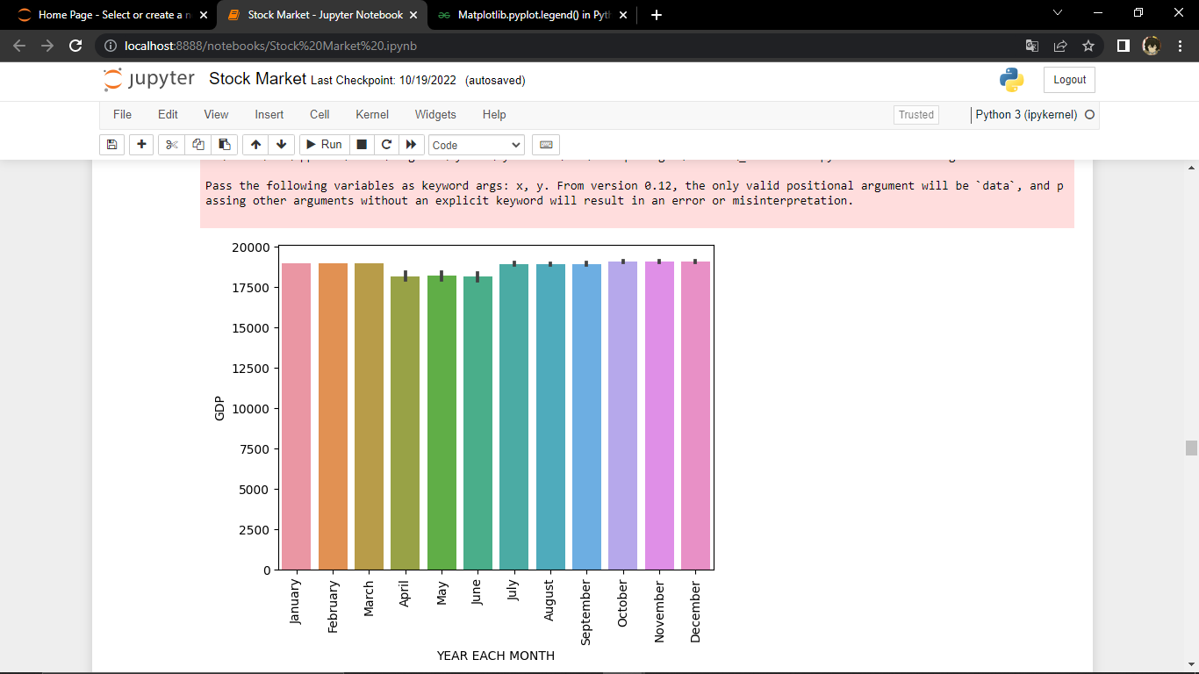
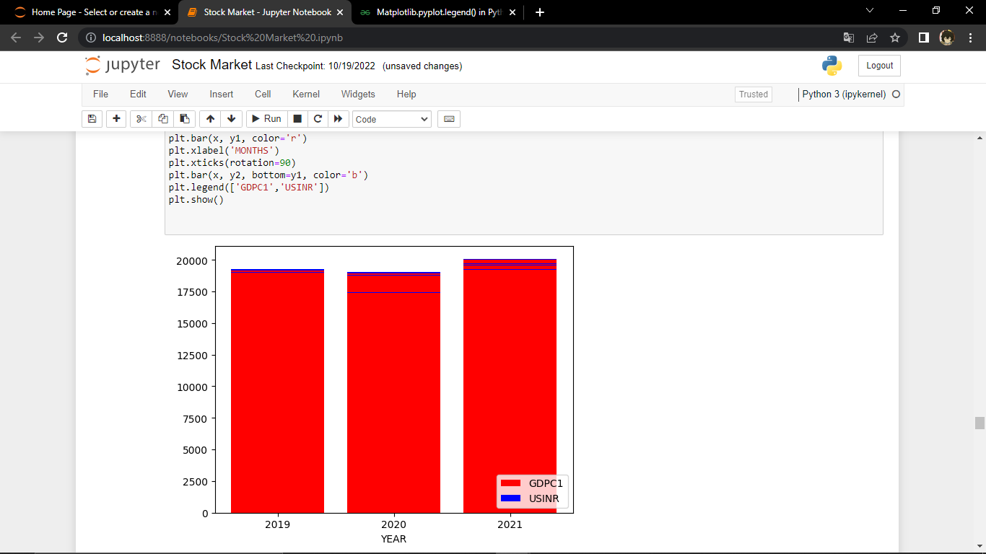
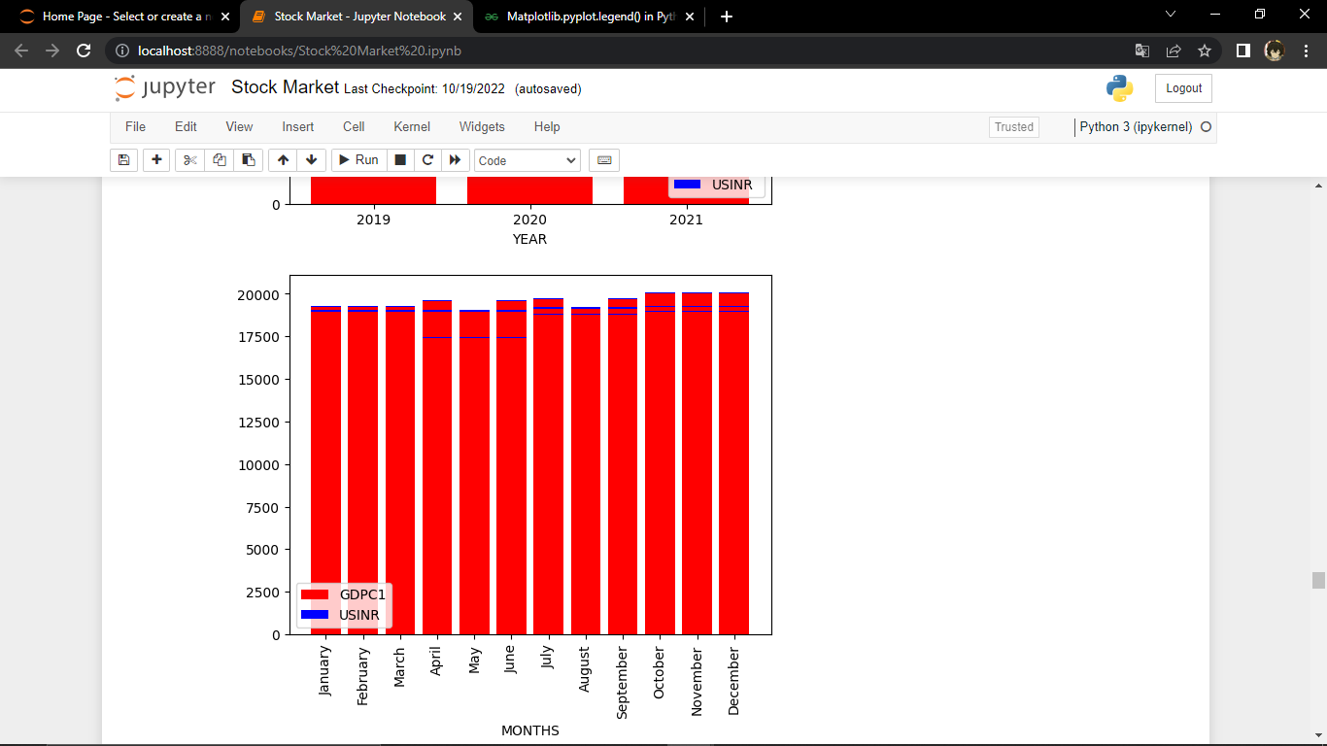
GDP OVER MONTHS AND YEAR:
If GDP is falling, then the economy is shrinking - bad news for businesses and workers. You can see the economy was decreased compared to 2019.
In each of nine quarters prior to March 2020, the GDP growth rate was lower, reaching 3.6% in the January–March 2020 quarter, with 2019–2020 ending with a 4.1% GDP growth, the lowest in over two decades.

Slide 11
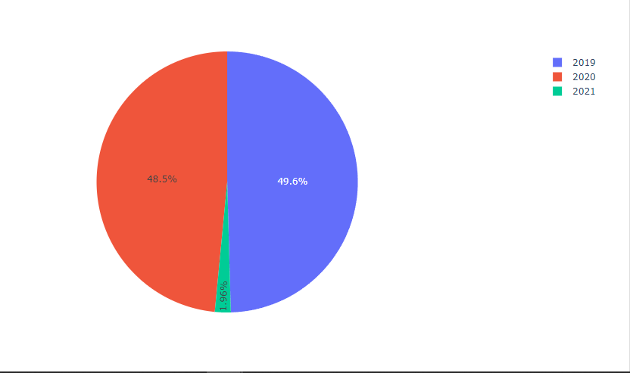
GDP over 2019-2021 (PIE CHART):
There was was 1.1% decreased in GDP in data which also results or show the economy shrinked or decreased the USINR ,which again shows the GDP decreased shows the India economy decreased.

Slide 12
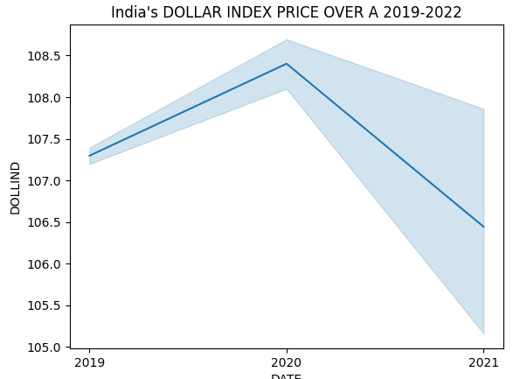
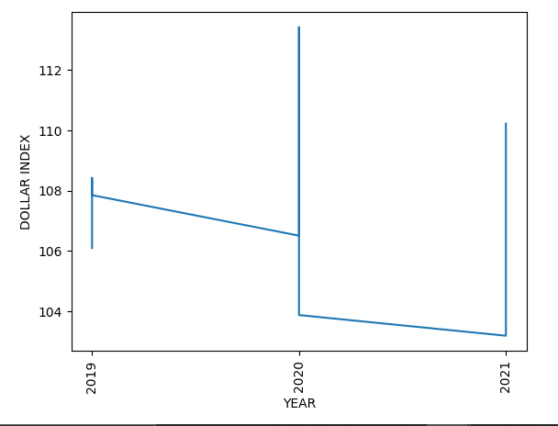
DOLLAR INDEX ON INDIA ECONOMY:
The Dollar Index was increased over the year of 2020 which results to change in india economy then its become stable and decreased and stable over the 2021.

Slide 13
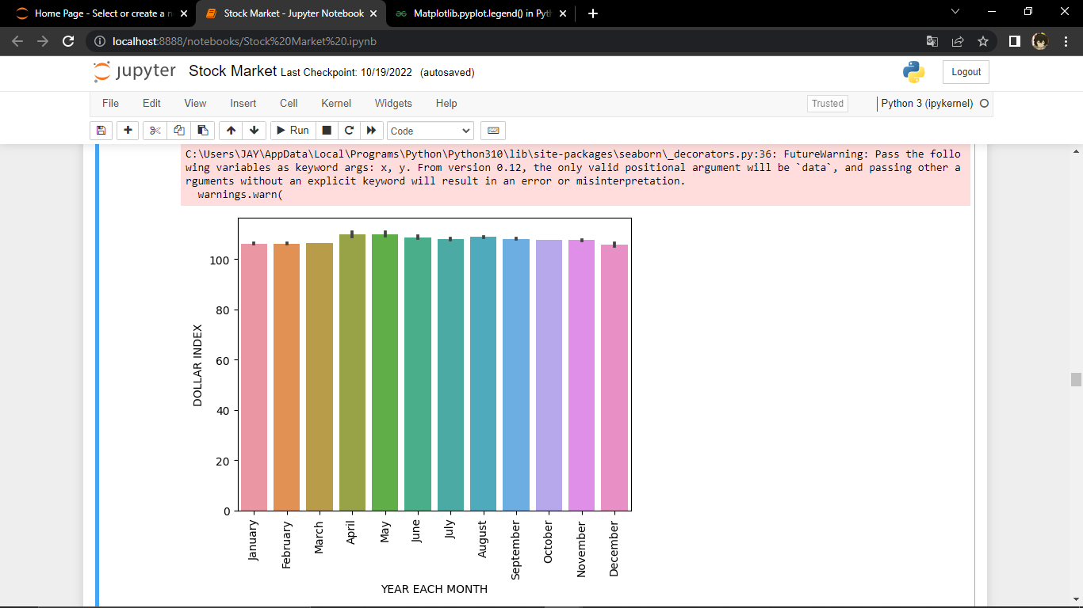
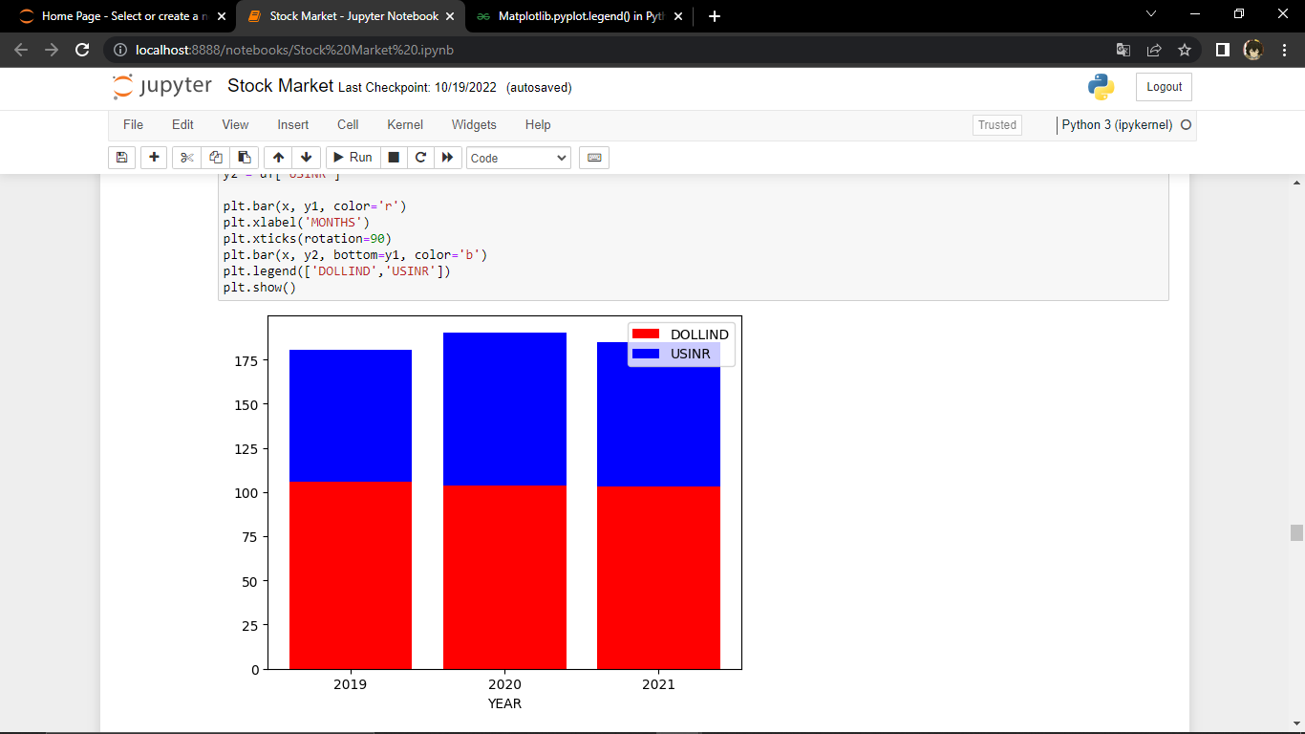
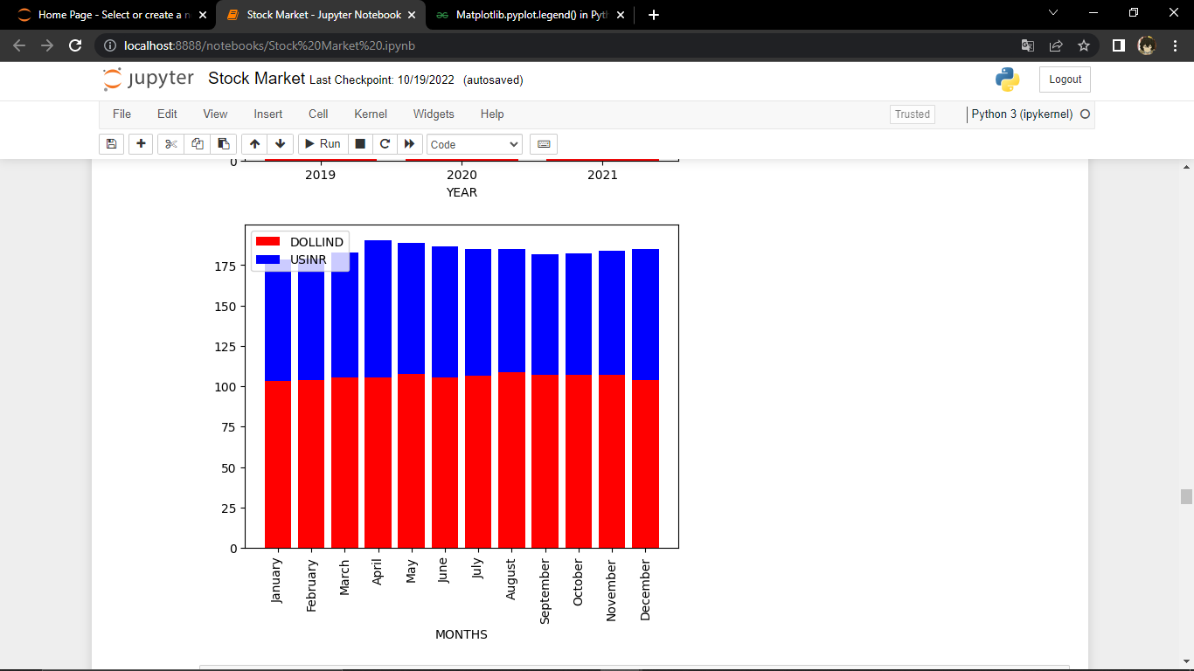
DOLLAR INDEX OVER MONTHS AND YEAR:
DOLLAR INDEX INCREASED OVER THE PERIOD OF MARCH – MAY WHICH WAS AGAIN THE COVID ACTIVE ZONE OR PERIOD WHICH RESULTS TO INDIA ECONOMY.

Slide 14
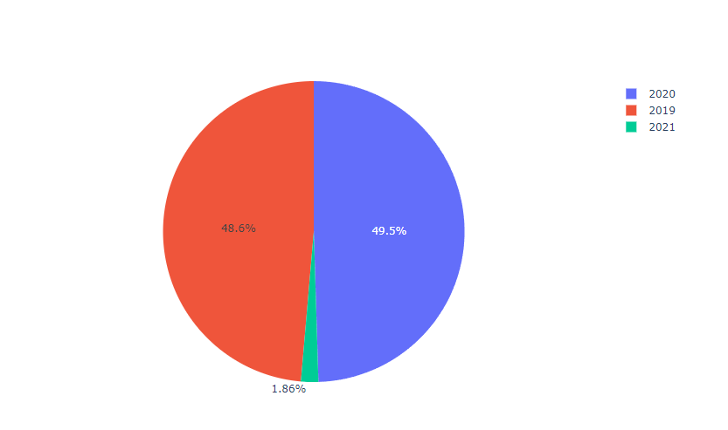
Dollar Index over 2019-2021 (PIE CHART):
The Dollar Index was increased in 2020 was 0.9% . This increased results to increased in India Economy.

Slide 15
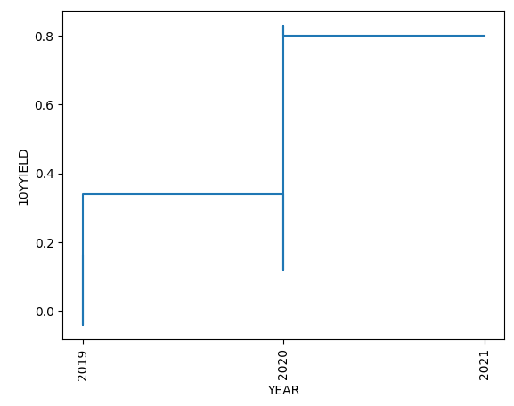
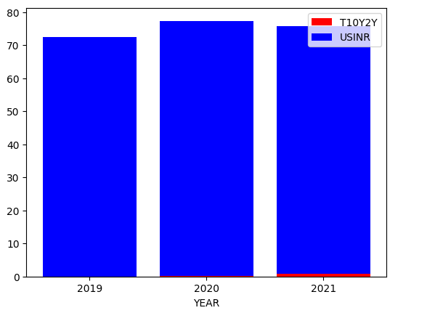
10-Year Yield ON INDIA ECONOMY:
The 10-Year Yield was decreased which results to increased in india economy compare to 2019.

Slide 16
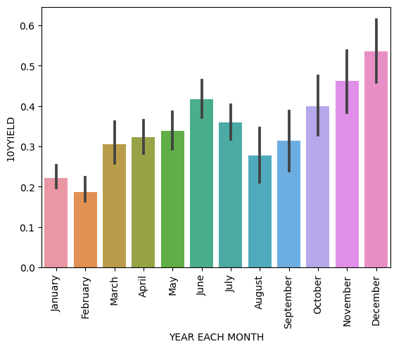
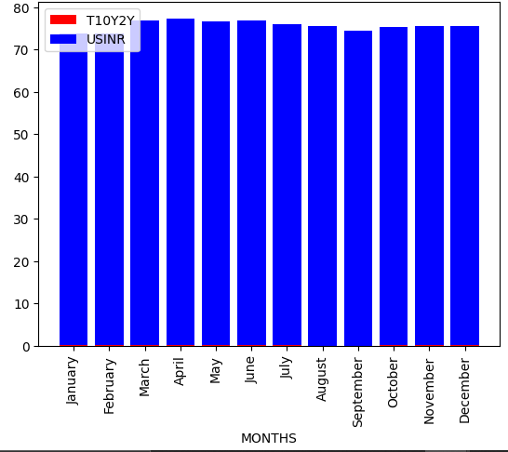
10-Year Yield OVER MONTHS AND YEAR:
The first wave of the COVID-19 pandemic commenced with increased detection of cases in January-March 2020, and after the September 2020 peak, cases declined by the end of October 2020. Second wave in India in April-May 2021 . You can see there is low yield in JAN – MAY which is mostly the active covid period in india which leads to the increase of the India Economy.

Slide 17
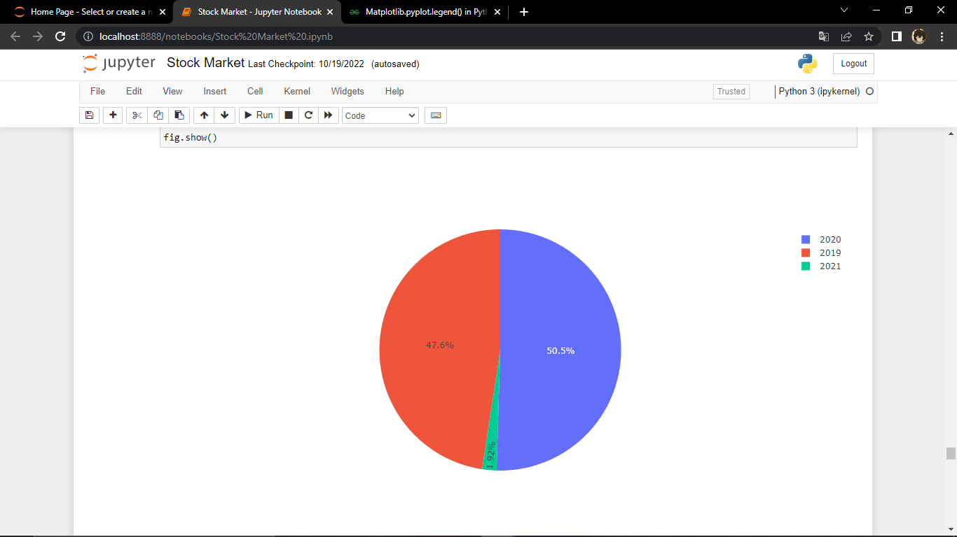
INIDIAN ECONOMY OVER 2019-2021
BY THIS YOU CAN SEE THERE WAS APPROX 3.5% INCREASED IN 2020 IN ECONOMY.

Slide 18
CONCLUSION:
Macroeconomic factor has do effected the India economy over the year 2019-2021 ,major reason was pandemic on 2020 where we see the major up-downs of factors which increased or effected the economy .
CRUDE OIL DECREASED BY 17.5% APPROX. 20% DECREASED IN CRUDE OIL PRICE
There was was 1.1% decreased in GDP in data which also results or show the economy shrinked
The Dollar Index was increased in 2020 was 0.9% .
There is low yield in JAN – MAY which is mostly the active covid period in india which leads to the decrease of the India Economy.
A macroeconomic factor may be considered positive, negative or neutral, based on the way it affects the economy. A natural disaster can negatively impact the production and sale of goods while higher production rates due to a demand for more goods are considered positive macroeconomic factors.
Macroeconomic factors can be positive, negative, or neutral.

